Slide 1
Debugging Triggers
Notes:
Schedule: Topic Timing
Lecture 40 minutes
Practice 25 minutes
Total 65 minutes

Slide 2
Objectives
After completing this lesson, you should be able to do the following:
  Describe the components of the Debug Console
  Run a form module in debug mode by using the Run Form Debug button
  Debug PL/SQL code
Notes:
Objectives
As you begin to add code to your form by writing triggers, you will probably find that you sometimes obtain incorrect or unexpected results. In a large application, it may be difficult to determine the source of the problem.
You can use Forms Builder’s integrated PL/SQL Debugger to locate and correct coding errors. This lesson explains how to debug your PL/SQL code.
Instructor Note
The PL/SQL Debugger integrated into Forms Builder also enables remote debugging. You can attach the debugger to a form that is already running by supplying the host name and port number for that application. However, in this course we present information to enable developers to debug the triggers they are writing, so this lesson discusses using the debugger on a form run from Forms Builder.

Slide 3
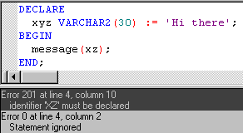
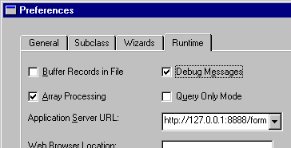

The Debugging Process
Monitor and debug triggers by:
  Compiling and correcting errors in the PL/SQL Editor
  Displaying debug messages at run time
  Invoking the PL/SQL Debugger
Notes:
The Debugging Process
With Forms Builder you can monitor and debug triggers in several ways:
Compiling: Syntax errors and object reference errors (including references to database objects) are reported when you compile a trigger or generate the form module. This enables you to correct these problems in the PL/SQL Editor before run time.
Running a form with run time parameter debug_messages=Yes: In Debug mode, you can request messages to be displayed to indicate when triggers fire. This helps you to see whether certain triggers are firing, their origin and level, and the time at which they fire. If an error occurs, you can look at the last trigger that fired to narrow the scope of the source of the error.
Invoking the PL/SQL Debugger: You invoke the debugger from Forms Builder by clicking Run Form Debug on the toolbar.
With the Debugger you can monitor the execution of code within a trigger (and other program units). You can step through the code on a line-by-line basis, and you can monitor called subprograms and variables as you do so. You can also modify variables as the form is running, which allows you to test how various changes in form item values and variable values will affect your application.

Slide 4
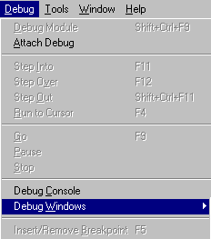
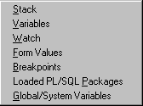
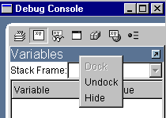
The Debug Console
  Stack
  Variables
  Watch
  Form Values
  PL/SQL
  Packages
  Global and
  System Variables
  Breakpoints
Dock/
Undock
Click
bar for
Pop-up
Menu
Notes:
The Debug Console
The debug console is a workspace in Forms Builder that enables you to see various aspects of the running form and its environment. You display the debug console by selecting Debug > Debug Console from the menu. It displays automatically when you encounter a breakpoint in a form that is running in debug mode.
Within the console, you can display several types of panels: Stack, Variables, Watch, Form Values, Breakpoints, PL/SQL Packages, and Global and System Variables. You can resize the debug console and any of the panels displayed within it.
You choose which panels to display or close by clicking the toggle buttons on the toolbar of the Debug Console, or by selecting Debug > Debug Windows from the menu. As you show and hide panels within the console, the panels automatically expand and contract to fill the console.
You can undock any of the panels to display them outside the Debug Console by clicking the upward pointing arrow in the top right of the panel; you redock the panel by clicking its downward pointing arrow.
If you right click the area beside the dock/undock arrow, you will see a pop-up menu enabling you to hide, dock, or undock the panel.

Slide 5

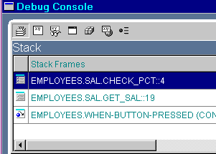
The Debug Console: Stack Panel
  Stack
  Variables
  Watch
  Form Values
  PL/SQL
  Packages
  Global and
  System Variables
  Breakpoints
Notes:
The Debug Console: Stack Panel
The call stack represents the chain of subprograms starting from the initial entry point down to the currently executing subprogram. The program currently executing in the example above is EMPLOYEES.SAL.CHECK_PCT, which was called by EMPLOYEES.SAL.GET_SAL. This program was called from a When-Button-Pressed trigger, the initial entry point of the current call stack. As you can see, frames are listed in the reverse order in which the subprograms were executed. The earliest frame is at the bottom of the stack, while the latest frame is at the top of the stack.
A stack frame contains information about the corresponding subprogram, including the module name, the package name if any, the subprogram name, and the next statement that is to be executed. For example, EMPLOYEES.SAL.GET_SAL::19 indicates that line 19 of subprogram GET_SAL in the SAL package contained in the EMPLOYEES module will be executed when the application returns to that subprogram. When that occurs, the EMPLOYEES.SAL.CHECK_PCT frame will get pushed off the stack because the EMPLOYEES.SAL.CHECK_PCT subprogram has finished executing.

Slide 6

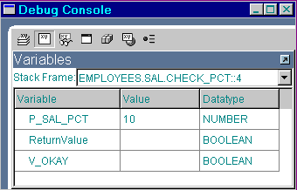
The Debug Console: Variables Panel
  Stack
  Variables
  Watch
  Form Values
  PL/SQL
  Packages
  Global and
  System Variables
  Breakpoints
Read-only:
Modifiable:
Notes:
The Debug Console: Variables Panel
The variables panel displays the variables of the current stack frame, along with their values. There is a pop-up list from which you can select the stack frame whose variables you want to view. You can also switch the variables shown in the variable panel by clicking a different stack frame in the stack panel if it is open as well. This does not change the order of execution of program statements, but only the information that is displayed in the debug console.
A feature of the debugger is that when the form is suspended you can change the variable values by clicking into the value column and entering a new value. When the program continues, it will use the new value that you have entered, so that you can test the effect of changing a value on the final result.
Some variables, such as parameters, cannot be modified. When you click into a read-only variable, the entire cell is highlighted. Clicking into a modifiable variable will highlight only the value, not the entire cell.

Slide 7

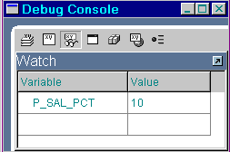
The Debug Console: Watch Panel
  Stack
  Variables
  Watch
  Form Values
  PL/SQL
  Packages
  Global and
  System Variables
  Breakpoints
Notes:
The Debug Console: Watch Panel
A running application may have dozens of variables that can be displayed in various panels in the debug console, but there may be very few that you need to monitor. The Watch panel provides a central place where you can keep track of any valid variables that you specify. Only variables which resolve to a scalar value are valid. Stored package variables are not valid.
Once a variable is displayed in your watch list, when execution is next suspended at a different location, the variable values in the list are updated as needed if they are available in the current execution context. If a variable is not defined in the currently executing subprogram, #### displays in the cell instead of a value.
To add a variable to the Watch panel, perform the following steps:
1. Open the window where the variable is displayed.
2. Select the variable that you want to add to the Watch panel.
3. Right-click the selection and choose Add to Watch from the pop-up menu.
To delete an item from the Watch panel:
Select it in the Watch panel, right-click, and choose Remove from the pop-up menu.
To clear the entire Watch panel, choose Remove All.

Slide 8

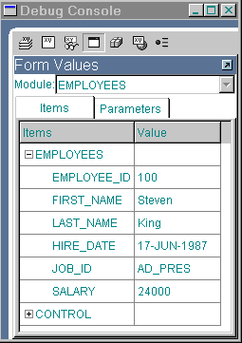
The Debug Console: Form Values Panel
  Stack
  Variables
  Watch
  Form Values
  PL/SQL
  Packages
  Global and
  System Variables
  Breakpoints
Notes:
Debug Console: Form Values Panel
You can use the form values panel to display the values of all items and parameters in modules that are currently running. You switch between a view of items and a view of parameters by clicking the corresponding tabs in the panel.
You can change the values of modifiable items to test the effects of such changes. If the value is read-only, such as display item values, the entire cell is highlighted when you try to edit it. If the value is modifiable, only the value in the cell is highlighted when you select it.

Slide 9

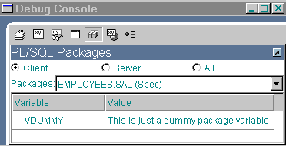
The Debug Console:
PL/SQL Packages Panel
  Stack
  Variables
  Watch
  Form Values
  PL/SQL
  Packages
  Global and
  System Variables
  Breakpoints
Notes:
The Debug Console: PL/SQL Packages Panel
Use the PL/SQL Packages panel to browse and examine PL/SQL packages that have been instantiated. Both package specification and package body global variables are listed. You can view packages only while the runform process is currently executing PL/SQL. You can also select an option button to determine which packages are displayed: Client, Server, or All.

Slide 10

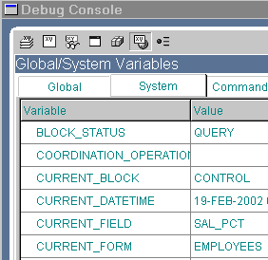
The Debug Console:
Global/System Variables Panel
  Stack
  Variables
  Watch
  Form Values
  Loaded PL/SQL
  Packages
  Global and
  System Variables
  Breakpoints
Notes:
Debug Console: Global/System Variables Panel
Use the Global/System Variables panel to display the current system, global, and command line variables and their values. You can switch among these types of variables by clicking the corresponding tabs in the panel.
Command line variables and most system variables are read-only. The only modifiable system variables are DATE_THRESHOLD, EFFECTIVE_DATE, MESSAGE_LEVEL, and SUPPRESS_WORKING. You can modify global variables, and the new values will be used subsequently by the running application.

Slide 11

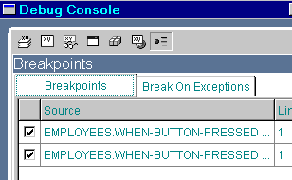
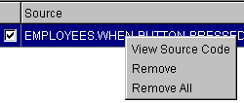
The Debug Console: Breakpoints Panel
  Stack
  Variables
  Watch
  Form Values
  Loaded PL/SQL
  Packages
  Global and
  System Variables
  Breakpoints
Notes:
The Debug Console: Breakpoints Panel
The Breakpoints panel consists of two tabs:
Breakpoints tab displays any breakpoints set in the code during the current Forms Builder session, in order of breakpoint creation.
Display includes:
Name of trigger or program unit
Line number where breakpoint is set
A check box to temporarily enable or disable the breakpoint.
Enables navigation to source code where breakpoint is set:
By double-clicking the breakpoint name
By highlighting (single-clicking) it, then choosing View Source Code from the pop-up menu (right-click in Windows). From this pop-up menu, you can also remove the breakpoint or remove all breakpoints.

Slide 12
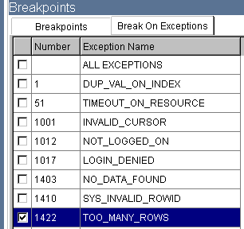
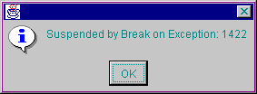
The Debug Console
  Stack
  Variables
  Watch
  Form Values
  Loaded PL/SQL
  Packages
  Global and
  System Variables
  Breakpoints
Notes:
The Debug Console: Breakpoints Panel (continued)
The Break On Exceptions tab displays a list of frequently used system exceptions that you can use during debugging. The display includes:
Exception name
Associated ORA- error number
Check box where you set or unset the breakpoint

Slide 13
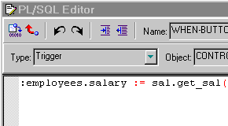
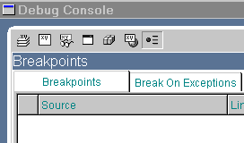
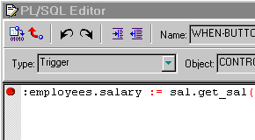
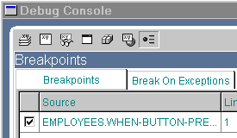
Setting Breakpoints in Client Code
Breakpoints:
  Suspend form execution
  Return control to the debugger
  Remain in effect for the Forms Builder session
  May be enabled and disabled
  Are set in the PL/SQL Editor on executable lines of code
Before setting breakpoint:
After setting breakpoint:
Notes:
Setting Breakpoints in Client Code
You set breakpoints in code so that the form running in debug mode will be suspended when a breakpoint is encountered and control will return to the Forms Builder debugger, allowing you to monitor or change the environment at that point. When you set a breakpoint, it remains set until you exit the Forms Builder session. However, you can disable and enable breakpoints as needed by unchecking and rechecking the check box in the Breakpoints panel of the Debug Console.
You can set breakpoints only on executable lines of code, such as assignments or subprogram calls. There are three ways to set a breakpoint:
By double-clicking to the left of a line of code in the PL/SQL Editor
By right-clicking a line of code and selecting Insert/Remove Breakpoint.
By choosing Debug > Insert/Remove breakpoint from the main menu.
Performing the same action again unsets the breakpoint. You can also remove one or all breakpoints from the pop-up menu in the Breakpoint panel, as described previously.

Slide 14
Setting Breakpoints in Stored Code
  Can set on stored program units:
    Expand Database Objects node
    Expand <schema> node
    Expand PL/SQL Stored Program Units node
    Double-click program unit
    Set breakpoint in PL/SQL Editor
  Cannot set on database triggers or stored PL/SQL libraries
  Compile with debug information
Notes:
Setting Breakpoints in Stored Code
If you are connected to the database, you can set breakpoints in stored packages, procedures, and functions just as you do in client-side programs. To do so:
1. Expand the Database Objects node.
2. Navigate to the stored subprogram.
3. Open it in the PL/SQL Editor.
You cannot set breakpoints in database triggers or stored PL/SQL libraries.
If the program unit does not appear in a stack frame, or if you are not able to see it as you step through its code, it has not been compiled with debug information included. There are three methods to compile the stored program unit with debug information:
Create the stored procedure in Forms Builder, which creates it with debugging information.
Use ALTER SESSION SET PLSQL_DEBUG=TRUE before creating the stored procedure.
Manually recompile an existing PL/SQL program unit using:
ALTER PROCEDURE <schema.procedure> COMPILE DEBUG

Slide 15
Debugging Tips
  Connect to the database for SQL compilation.
  The line that fails is not always responsible.
  Watch for missing semicolons and quotation marks.
  Define triggers at the correct level.
  Place triggers where the event will happen.
Notes:
General Tips to Solve Trigger Problems
Make sure you are connected to the (correct) database when you compile triggers that contain SQL. Error messages can be deceiving.
The PL/SQL Editor reports the line that fails, but the error may be due to a dependency on an earlier line of code.
Missing semicolons (;) and mismatched quotes are a common cause of compile errors. Check for this if a compile error does not give an obvious indication to the problem.
If a trigger seems to fire too often, or on the wrong block or item in the form, check whether it is defined at the required level. For example, a form-level When-Validate-Item trigger fires for every changed item in the form. To check this, you can run the form with Debug Messages on.
For triggers that populate other items, make sure the trigger belongs to the object where the firing event will occur, not on the items to be populated.

Slide 16
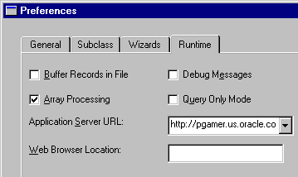
Running a Form in Debug Mode
Run Form
Debug
(Compiles automatically)
Contains source
code and
executable run file
.FMX
(Runs automatically)
Runs Form in
Debug Mode on
Server specified
in Runtime Preferences
Notes:
Running a Form in Debug Mode
The Run Form Debug button in Forms Builder runs the form in debug mode. When a breakpoint is encountered and control passes to the Debugger in Forms Builder, you can use the debug commands to resume execution or step through the code in a variety of ways to see how each line affects the application and the environment, as you will see shortly.
As when you run a form from Forms Builder with the Run Form button, the Run Form Debug button runs the form in a three-tier environment. It takes its settings from the Preferences window that you access by choosing Edit > Preferences from the main menu and clicking the Runtime tab.
You enter the URL for the application server that you want to run the form, which runs in your default browser unless you specify a different browser in the Web Browser Location text box. You can use a named configuration, if desired, with the config parameter.
Example of Application Server URL:
http://mymachine:8888/forms90/f90servlet?config=test
where test is a named section in the Forms Web configuration file(formsweb.cfg by default) that specifies settings to use.

Slide 17
Stepping through Code
Step over
Pause
Stop
Step
into
Step
out
GO
Notes:
Stepping through Code
Once the program encounters a breakpoint, the PL/SQL Debugger enables you to step through program units in a variety of ways in order to examine the environment as the program progresses, using the following buttons:
Step Into: Executes the next statement
Step Over: Executes the next statement without stepping into a nested subprogram
Step Out: Completes the nested subprogram and steps to the next executable statement in the calling program
Go: Resumes execution until the program terminates normally or is interrupted by the next breakpoint
Pause: Pauses the execution of running PL/SQL code to enable you to examine the environment. For example, you could check variable values.
Stop: Terminates debugging and program execution completely; the Debug Console and any opened debug panels close and application execution terminates.
Another command, available from the Debug menu, is Run to Cursor. When you insert the mouse cursor on a line of code in the PL/SQL Editor (by clicking on it), the Run to Cursor command executes all code up to that line, then stops and marks that line as the next executable line of code.

Slide 18
Debug Example
Debug Example
WHEN-BUTTON-
PRESSED
The results are: ??
1
…calls...
5
Procedure XYZ;
2
4
Function ABC;
3
Notes:
Debug Example
This simple example demonstrates some of the basic features available in the debugger. The example form consists of a single button with trigger code for the When-Button-Pressed event. The code works as follows:
1. The trigger calls the XYZ procedure, passing it a value for the xyz_param input parameter.
2. The XYZ procedure calls the ABC function passing it a value for the abc_param input parameter.
PROCEDURE xyz(xyz_param IN NUMBER) IS
v_results NUMBER;
BEGIN
v_results := ABC(10);
v_results := v_results + xyz_param;
MESSAGE(‘The results are: ‘ || TO_CHAR(v_results));
END xyz;

Slide 19
Notes:
Debug Example (continued)
3. The ABC function multiplies two variables and adds the result to the abc_param input parameter.
4. The ABC function returns the result to the XYZ procedure.
5. The XYZ procedure adds the result to the xyz_param and displays it in the console at the bottom of the form window.
FUNCTION abc (abc_param IN NUMBER) RETURN NUMBER IS
v_total NUMBER := 0;
v_num2 NUMBER := 3;
v_num6 NUMBER := 8;
/*-- wrong value should be 6 */
BEGIN
v_total := v_num3 * v_num6;
v_total := v_total + abc_param;
RETURN v_total;
END abc;
Instructor Note
Demonstration
Open the form DebugDemo.fmb in Forms Builder to show the students how to use the debugger.
First run the form normally. When you click Debug Example in the form, “134” displays at the bottom of the screen (console). However, the expected results were “128.” The syntax must be correct because everything compiled correctly. So, there must be something wrong in the logic of the application code within the form. The developer needs to debug the code to find why it produced the wrong results.
Set a breakpoint in the When-Button-Pressed trigger for Block1.push_button1 on the executable line that calls the procedure.
Click Run Form Debug to run the DebugDemo form in Debug mode.
Click Debug Example in the form. The program stops at the breakpoint.
The XYZ procedure now displays in the PL/SQL Editor, with “=>” to mark current position at the beginning of the executable code.
If not already displayed, bring up the Debug Console and demonstrate the Breakpoints, Variables, and Stack panels.
Click Step Into in the Debugger to advance into the XYZ procedure.
Examine the Stack values for the xyz_param and v_results parameters (as well as system variables). Everything looks normal in the xyz procedure.
Click Step Into to enter the ABC function. Step through each of the opening assignment statements. Find the problem in the code (v_num6 is incorrectly set to 8 instead of 6).
Before proceeding, in the Variables panel, change the value of the variable to 6. Then, click Go.
Return to the form to see that the correct result of 128 is now obtained. Point out to students that to correct the problem permanently, the PL/SQL would need to be corrected.

Slide 20
Notes:
Debug Example (continued)
Instructor Note (continued)
In previous versions of Forms, you could change PL/SQL code on the fly in the debugger. However, now that the debugger is integrated into Forms Builder, and the form itself is running in a three-tier environment, this is no longer possible.
If a more complex demo is desired, open and run EMPLOYEES.fmb:
The various buttons in this form enable you to demonstrate the Package and Break on Exceptions windows.
The Cause Exception button in the form causes a 1422 exception, so select that as the exception on which to break.
The code error in the form is that the Update Salary button does not seem to change the salary. Set a breakpoint in the When-Button-Pressed trigger for that button. The actual error occurs in the sal.get_sal package procedure, which is called by the When-Button-Pressed trigger of the Update Salary button. The lines:
IF p_action = ‘UPDATE’ THEN
v_new_sal := p_old_sal;
END IF;
should be corrected to:
IF p_action = ‘UPDATE’ THEN
v_new_sal := p_old_sal + v_new_sal;
END IF;

Slide 21
Summary
In this lesson, you should have learned that:
  The Debug Console consists of panes to view the call stack, program variables, a user-defined watch list, Form values, loaded PL/SQL packages, global and system variables, and breakpoints
  You use the Run Debug button to run a form module in debug mode within Forms Builder
  You can set breakpoints in the PL/SQL Editor by double-clicking to the left of an executable line of code
  The debug buttons in the Forms Builder toolbar enable you to step through code in various ways
Notes:
Summary
To debug a form from within Forms Builder, you can:
Click Run Form Debug (compiles and runs the form automatically)
Set breakpoints in the code
Use various panes of the Debug Console to view aspects of the running form
Use the debug-related toolbar buttons to step through the code

Slide 22
Practice 14 Overview
This practice covers the following topics:
  Running a form in debug mode from Forms Builder
  Setting breakpoints
  Stepping through code
  Viewing variable values while form is running
Notes:
Practice 14 Overview
In this practice session, you will run a form in debug mode from within Forms Builder, set a breakpoint, and step through code, looking at variable values as the form runs.
Note
For solutions to this practice, see Practice 14 in Appendix A, “Practice Solutions.”

Slide 23
Notes:
Practice 14
1. Open your CUSTGXX.FMB file. In this form, create a procedure that is called List_Of_Values. Import code from the pr14_1.txt file:
PROCEDURE list_of_values(p_lov in VARCHAR2,p_text in VARCHAR2) IS
v_lov BOOLEAN;
BEGIN
v_lov:= SHOW_LOV(p_lov);
IF v_lov = TRUE THEN
MESSAGE('You have just selected a‘||p_text);
ELSE
MESSAGE('You have just cancelled the List of Values');
END IF;
END;
2. Modify the When-Button-Pressed trigger of CONTROL.Account_Mgr_Button in order to call this procedure. Misspell the parameter to pass the LOV name.
When-Button-Pressed on CONTROL.Account_Mgr_LOV_Button:
3. Compile your form and click Run Form to run it. Press the LOV button for the Account Manager. Notice that the LOV does not display, and you receive a message that 'You have just cancelled the List of Values‘.
4. Now click Run Form Debug. Set a breakpoint in your When-Button-Pressed trigger, and investigate the call stack. Try stepping through the code to monitor its progress. Look at the Variables panel to see the value of the parameters you passed to the procedure, and the value of the p_lov variable in the procedure. How would this information help you to figure out where the code was in error?

